Slide 1
Using a Quantum genetic algorithm for cybersecurity budget allocation
AYUSH HARIHARAN

Slide 2
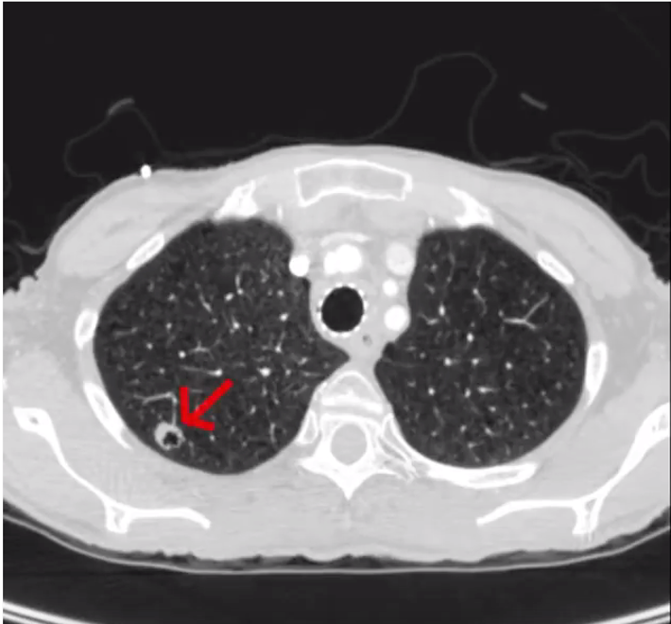
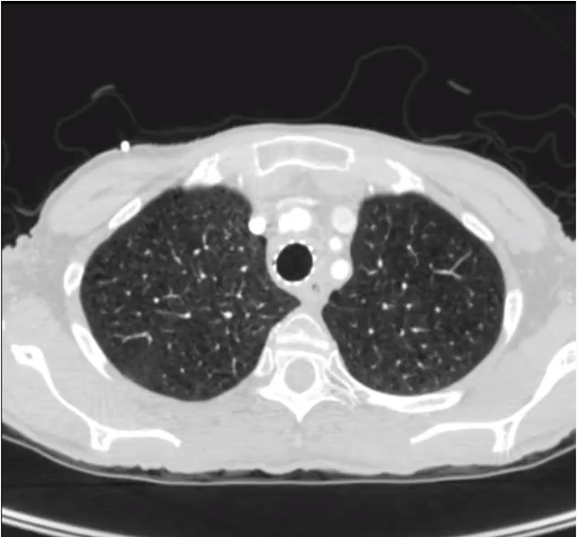

The Value of Data – financial ruin
The value of data – life or death
“Every single Yahoo account was hacked -- 3 billion in all” - CNN
Normal Scan
Altered Scan
“Under Armor says data hacked from 150 million MyFitnessPal Accounts” - NBC
“Equifax Says Cyberattack May Have Affected 143 million in the US” – New York Times
https://money.cnn.com/2017/10/03/technology/business/yahoo-breach-3-billion-accounts/index.html
https://www.nbcnews.com/tech/security/under-armour-says-data-hacked-150m-myfitnesspal-app-accounts-n861406
https://www.nytimes.com/2017/09/07/business/equifax-cyberattack.html
All Images from Mirsky et al.

Slide 3
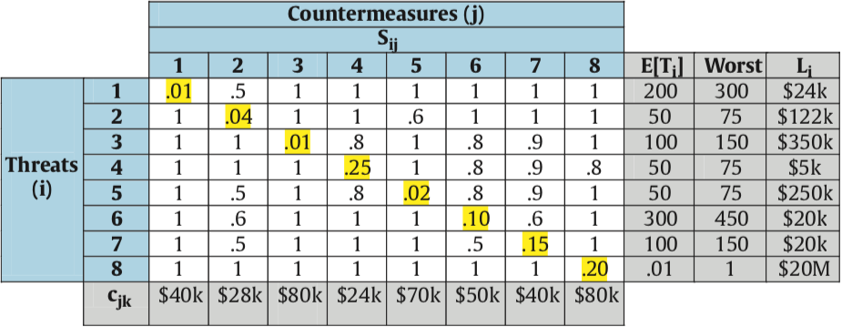
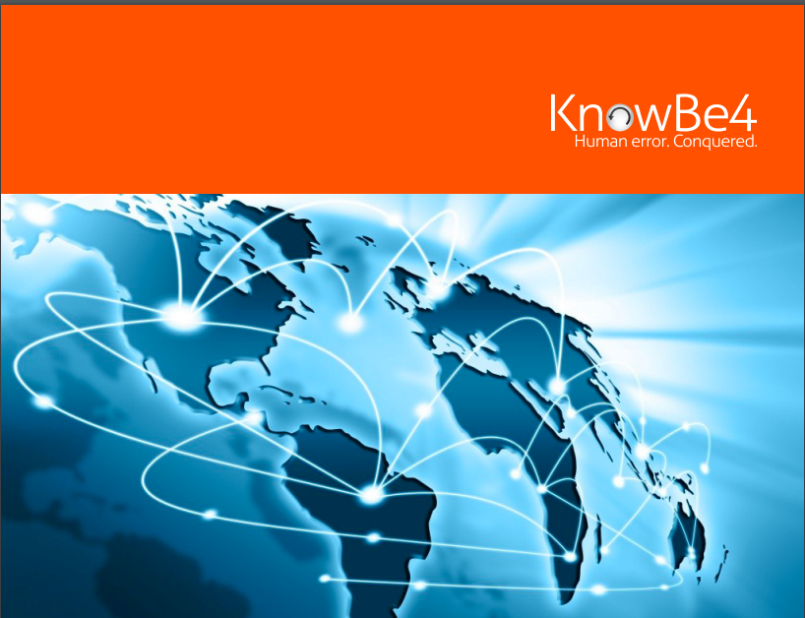
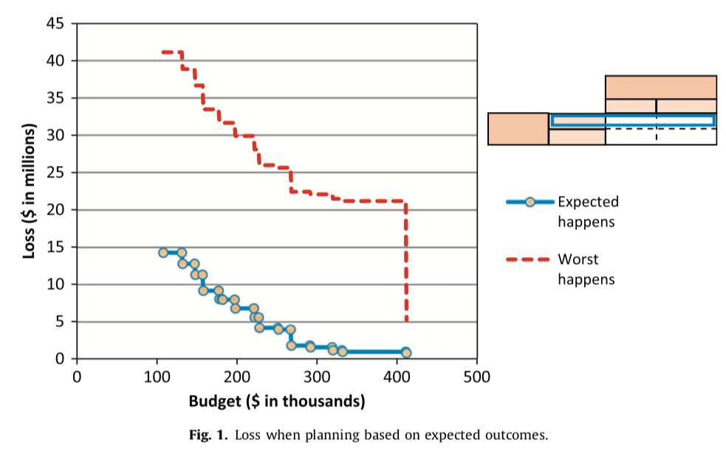
2016 endpoint protection report
All images from Rakes et. al

Slide 4
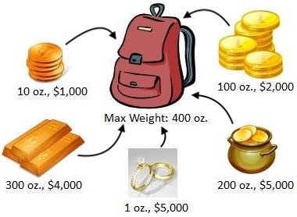
UNIQUENESS OF QUANTUM SAVE
https://www.cs.rpi.edu/academics/courses/spring12/proglang/pa3/pa3.html
https://www.theverge.com/2019/1/8/18171732/ibm-quantum-computer-20-qubit-q-system-one-ces-2019

Slide 5
The Final dataset
Knapsack Problem
Saves $76k, Costs $40k
80k budget
Saves $103k, Costs $60k
Saves $55k, Costs $20k

Slide 6
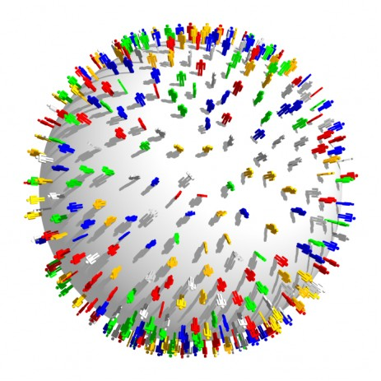
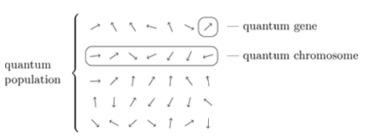
QUANTUM SAVE
Qubit as Counter Measure
https://owlcation.com/social-sciences/Human-Overpopulation-Its-Causes-Effects-and-Solutions
Row: CISO
Think Tank
https://www.thoughtco.com/charles-darwins-finches-1224472
https://www.smithsonianmag.com/science-nature/what-darwin-didnt-know-45637001/
https://www.nytimes.com/2019/10/21/science/quantum-computer-physics-qubits.html
https://www.youtube.com/watch?v=w56u2gv8XLs

Slide 7
The Power of the qubit
https://www.allaboutcircuits.com/news/aluminum-nitride-could-replace-diamond-in-qubit-creation/

Slide 8
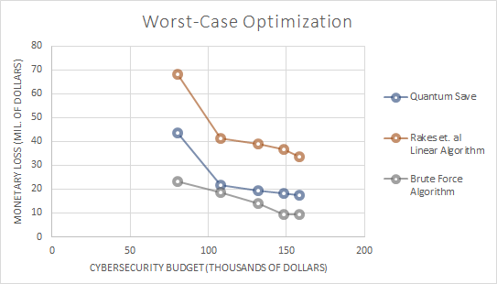
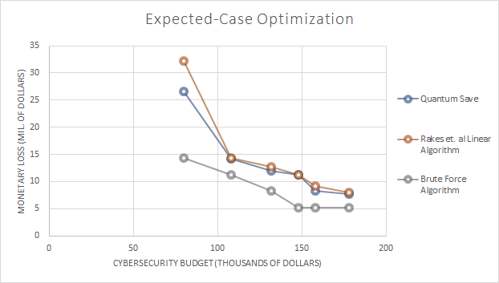
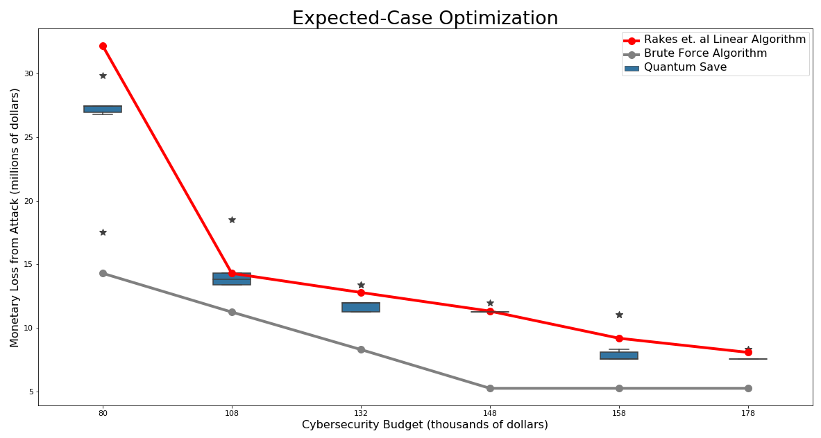
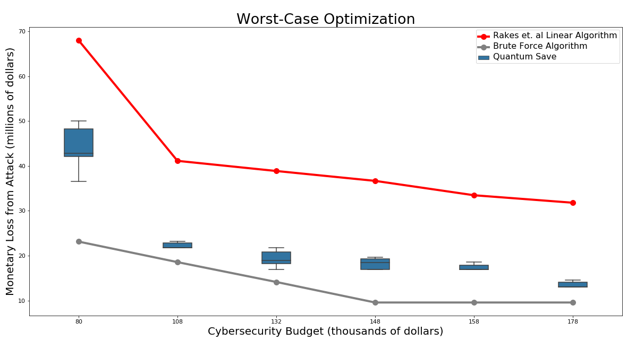
THE IMPACT OF QUANTUM SAVE
Budget | Improvement (%)
80k | 35.80
108k | 46.85
132k | 50.44
148k | 50.32
158k | 47.87
178k | 57.44
Budget | Improvement (%)
80k | 17.48
108k | 0.24
132k | 6.53
148k | 0.05
158k | 9.19
178k | 4.42
All Values in Dollars Unless Stated

Slide 9
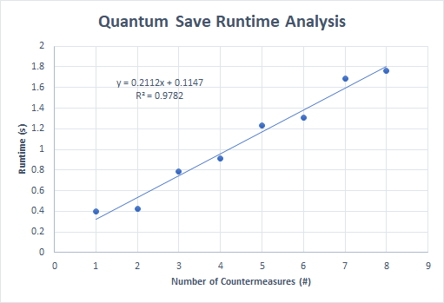
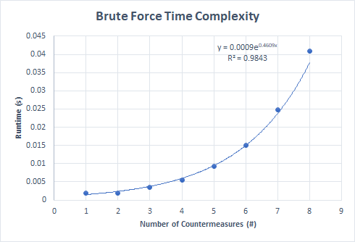
Time Complexity: quantum save VS brute force

Slide 10
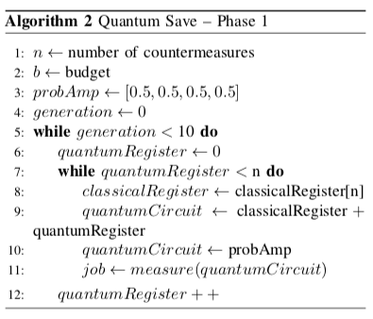
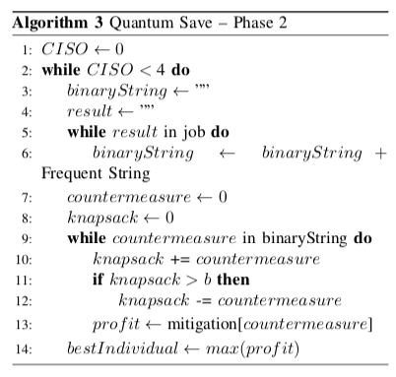
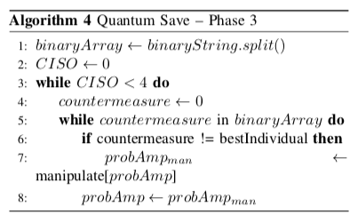
Theoretical Proof
Lemma: Quantum Save can allocate budget, b, when choosing from countermeasures with input-size, n, in O(n) time complexity with a linear time oracle for quantum measurement of a single register.

Slide 11
QUANTUM SAVE CAN HELP SMALL COMPANIES AND HOSPITALS SAVE MILLIONS OF DOLLARS BY EFFECTIVELY ALLOCATING BUDGETS!

Slide 12
Acknowledgements

Slide 13
References
2018 Deloitte NAISCO Cybersecurity Study (2014) www.nascio.org/Portals/0/Publications/Documents /2018/2018DeloitteNASCIOCybersecurityStudyfinal.pdf
Birkett, A. (2015). How to Get Over Local Maximum? Everyone Hits It Eventually. CXL. Retrieved 16 October 2019, from https://conversionxl.com/blog/local-maximum/
Bossaerts, P., Murawski, C. (2016). How Humans Solve Complex Problems: The Case of the Knapsack Problem. Nature Partner Journals. doi: 10.1038/srep34851
Chapman, W. L., Rozenblit, J., & Bahill, A. T. (2001). System design is an NP‐complete problem. Systems Engineering, 4(3), 222-229.
Fielder, A., Panaousis, E., Malacaria, P., Hankin, C., & Smeraldi, F. (2016). Decision support approaches for cyber security investment. Decision Support Systems, 86, 13-23.
Forrester, R., (2017, Jan 20). The Quantum Measurement Problem: Collapse of the Wave Function Explained. Social Science Research Network. http://dx.doi.org/10.2139/ssrn.2901820
Fu, C., Liu, J., Wang, H., & Zhi J. (2013, Mar 9). The Improvement of Quantum Genetic Algorithm and Its Application on Function Optimization. Hindawi, 2013. dx.doi.org/10.1155/2013/730749
Garg A., Goyal S. (2017). Vector Sparse Representation of Color Image Using Quaternion Matrix Analysis Based on Genetic Algorithm. Imperial Journal of Interdisciplinary Research, 3(7).
IBM Research Editorial Staff. (2018). An Open High-Performance Simulator for Quantum Circuits. IBM Research Blog. Retrieved 5 June 2019, from https://www.ibm.com/blogs/research/2018/05/quantum-circuits/
Kucharski, J., Nowotniak, R. (2012). GPU-based tuning of Quantum-Inspired Genetic Algorithm for a Combinatorial Optimization Problem. Bulletin of the Polish Academy of Science, 3(7). doi: 10.2478/v10175-012-0043-4
Kucharski, J., Nowotniak, R. (2014, Sept). Higher-Order Quantum-Inspired Genetic Algorithms. IEEE. doi: 10.15439/2014F99

Slide 14
References (cont.)
Mia, M. A. H., Rahman, M. A., & Uddin, M. (2007). E-Banking: Evolution, Status and Prospect. The Cost and Management, 35(1).
Mirsky, Y., Mahler, T., Shelef, I., & Elovici, Y. (2019). CT-GAN: Malicious tampering of 3D medical imagery using deep learning. In 28th {USENIX} Security Symposium ({USENIX} Security 19) (pp. 461-478).
Montanaro, A. (2016). Quantum Algorithms: An Overview. Nature Partner Journals. doi: 10.1038/npjqi.2015.23
Neves, J., Miguel, R. (1999). Preventing Premature Convergence to Local Optima in Genetic Algorithms via Random Offspring Generation. Lecture Notes in Computer Science, 1611, 127-136. https://doi.org/10.1007/978-3-540-48765-4\_16
Pan, Xiaohui & Zhang, Tao. (2018). Comparison and Analysis of Algorithms for the 0/1 Knapsack Problem. Journal of Physics: Conference Series. 1069. 012024. 10.1088/1742-6596/1069/1/012024.
Rachwald, R. (2008). Is banking online safer than banking on the corner? Computer Fraud & Security, 2008(3), 11–12. doi:10.1016/s1361-3723(08)70045-9
Rakes, T. R., Deane, J. K., & Paul Rees, L. (2012). IT security planning under uncertainty for high-impact events. Omega, 40(1), 79–88. doi:10.1016/j.omega.2011.03.008
The Copenhagen and Many Worlds Interpretations of Quantum Mechanics. (2019). Afriedman.org. Retrieved 16 October 2019, from http://afriedman.org/AndysWebPage/BSJ/CopenhagenManyWorlds.html

Slide 15
Any questions?

Slide 16
RESERVE – THEORETICAL PROOF (1)

Slide 17
Reserve -- theoretical proof (2)

Slide 18
Reserve – theoretical proof (3)

Slide 19
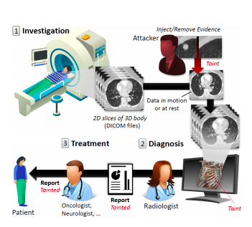
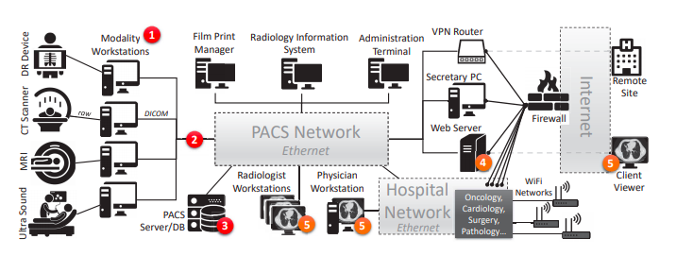
RESERVE – prominence of medical hacks
All Images from Mirsky et al.

Slide 20
Reserve – other types of hacks
Iranian Based Hackers (Iridium) hacked into Citrix Network 10 years ago
Recently, stole 6 terabytes of government data
Names, Social Security Numbers, and Financial Information Stolen
Hackers Stole Personal Information of 147.7 million Americans
Customer Names, Social Security Info, Addresses of Half the US Population
Russian Hackers Selling Access to US Government’s Internal Network
Opening Price is $60,000
https://krebsonsecurity.com/tag/miracle-systems-llc/
https://www.cnet.com/news/equifaxs-hack-one-year-later-a-look-back-at-how-it-happened-and-whats-changed/
https://www.sdxcentral.com/articles/news/citrix-internal-network-hacked-by-international-criminals/2019/03/
https://thehackernews.com/2017/09/equifax-credit-report-hack.html
Notes:
In recent years, the number of attacks on public corporations and government contractors has increased drastically.
Lets start in our own backyard. Miracle Systems in Arlington VA had confidential government data stolen and that data was sold on Russian Cybercrime Forums for 60,000 dollars.
Next, lets look at Citrix -- another government contractor. Recon spyware was put into Citrix systems by Iranian hackers over 10 years ago and nothing was done. Now, through two attacks, they stole 6 terrabytes of sensitive data.
Thats just on the government side. Sony, Target, Capital One, have all been targets of hackers.

Slide 21
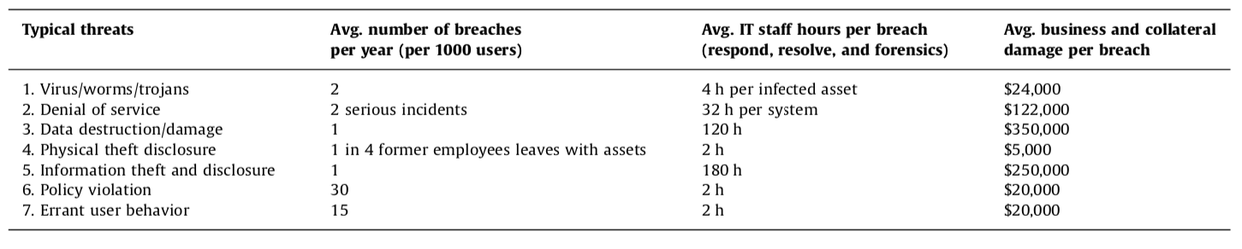
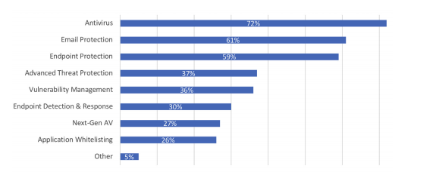
RESERVE – table abstraction removed
Rakes et al. (Citations)
https://www.knowbe4.com/hubfs/2018ThreatImpactandEndpointProtectionReport.pdf

Slide 22
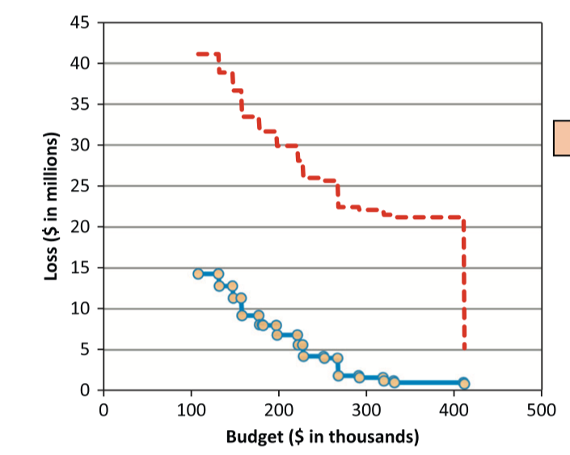
Reserve – full explanation of table
All images from Rakes et. al

Slide 23
Reserve – just the Table

Slide 24
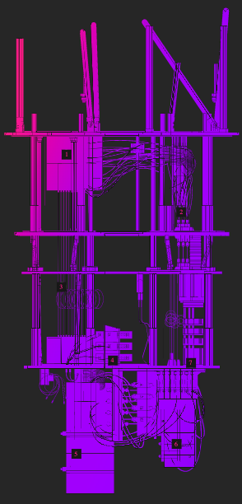
Reserve – how IBM quantum computer works

Slide 25
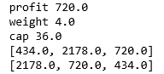
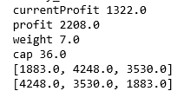
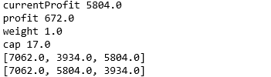
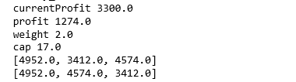
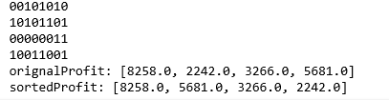
Reserve – choosing size of think-tank
3 Quantum Chromosomes, Old Knapsack Weight Cap
3 Quantum Chromosomes, New Knapsack Weight Cap
4 Quantum Chromosomes, New Knapsack Weight Cap

Slide 26
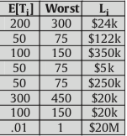
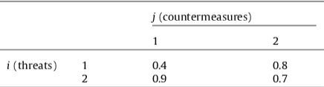
Reserve – rakes et al. linear model
1. P_{i} = (1 – Y₁e₁₁)(1 – Y₂e₁₂)
2. Loss = P_{i} * T_{i} * L_{i}
IT Security Planning Model
3. Constraint = c₁₁ Y₁ + c₁₂Y₂
4. Make it Linear

Slide 27
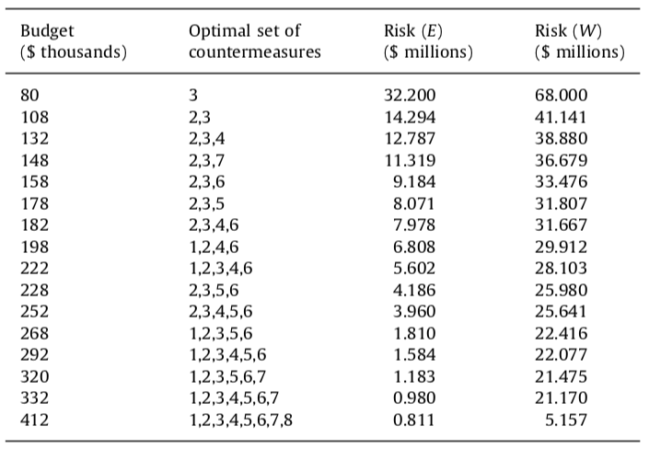
Reserve – Previous Research data

Slide 28
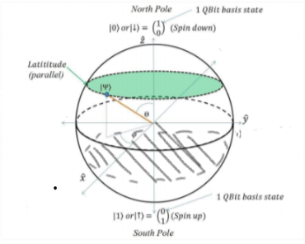
Reserve – phase 1 of quantum save
Countermeasure
Contractor

Slide 29
Reserve – phase 2 of quantum save
Countermeasures
Contractor with Best Defense

Slide 30
Reserve – disaster algorithm
https://conversionxl.com/blog/local-maximum/

Slide 31
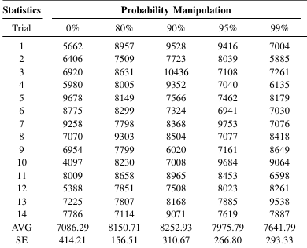
Reserve – tuning hyperparameters (amplitude)

Slide 32
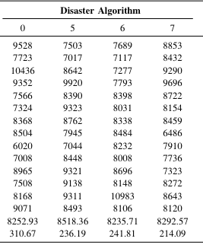
Reserve – tuning hyperparameters (disaster alg)

